Slide 1
North Carolina Tar Heels | History | College Basketball
By Michael McCulley aka DrWeb

Slide 2
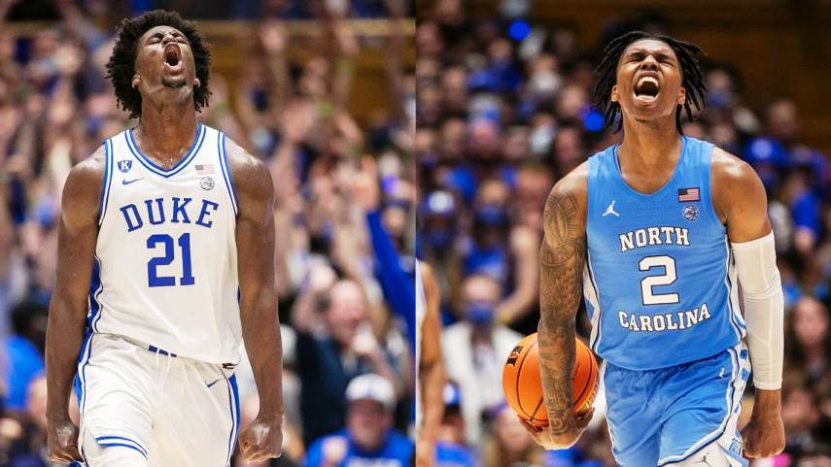
March Madness | UNC vs. Duke
NOTE:
To change images on this slide, select a picture and delete it. Then click the Insert Picture icon
in the placeholder to insert your own image.
Well, we're heading for a special Final Four in the NCAA Men's Basketball Tournament. North Carolina faces off against Duke, their arch rival in the Final Four. Amazingly, these two blueblood teams have never met before in the Tournament's history.
Image courtesy Raleigh News & Observer

Slide 3
Let’s look at some history and stats…
“The two schools have combined for 29 of the 65 ACC tournament titles and 51 regular-season crowns, made it to 36 Final Fours and claimed 11 national championships.”
Coaches:
North Carolina: Hubert Davis (23-8 career record; 23-8 at North Carolina); through March 5, 2022
Duke: Mike Krzyzewski (1,195-366 career record; 1,122-307 at Duke); through March 5, 2022
National championships:
North Carolina: 6 (1957, 1982, 1993, 2005, 2009, 2017)
Duke: 5 (1991, 1992, 2001, 2010, 2015)
Source: https://www.ncaa.com/news/basketball-men/article/2022-03-01/duke-vs-north-carolina-rivalry-wins-highlights-memorable-moments

Slide 4
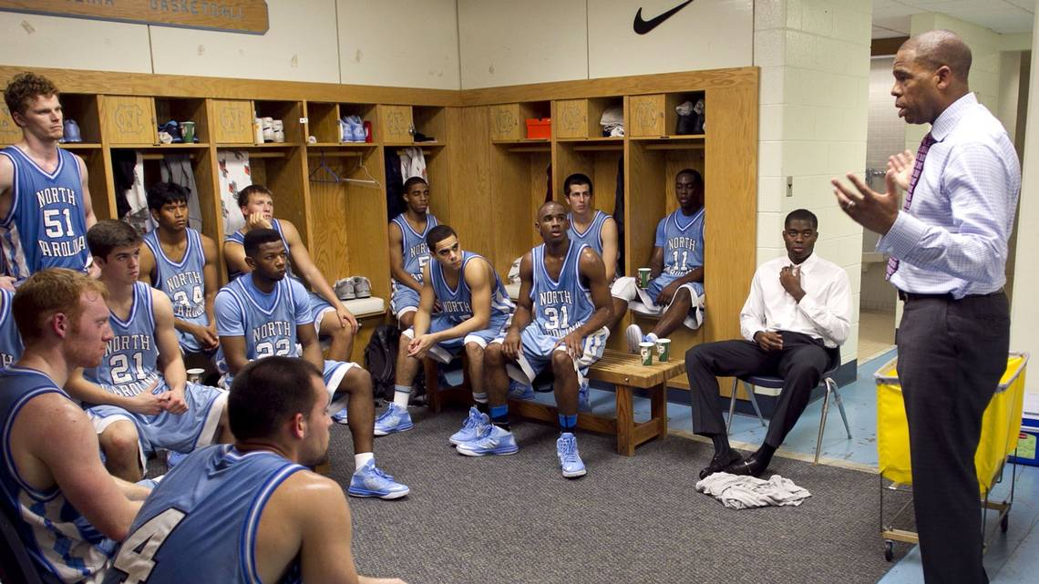
Let’s look at more history and stats…
“The Battle of North Carolina”
Photo source: https://www.newsobserver.com/
“The Duke vs. UNC Final Four game Saturday is one of the biggest North Carolina sporting events of all time. It might be stressful or even strain some relationships, but it’ll be an iconic moment for many sports fans in the Tar Heel State. What we’re all wondering: Who will win?”
Source: https://www.charlotteobserver.com/sports/college/mens-basketball/article259935990.html

Slide 5
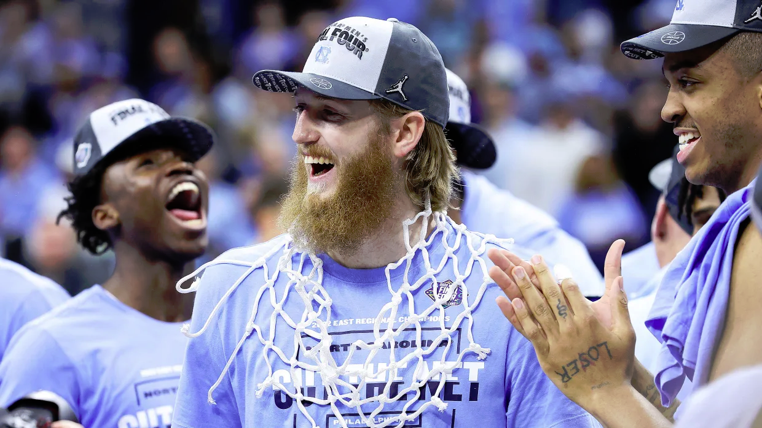
Tar Heel Summary
NORTH CAROLINA
FAMILIAR FINISH: This is North Carolina’s NCAA-leading 21st appearance in the Final Four. The Tar Heels also lead all schools with 130 victories in NCAA Tournament games.
SELECT COMPANY: North Carolina coach Hubert Davis is one of only two people to play and coach in the Final Four with the same school. Davis was on the 1991 North Carolina team that lost an NCAA semifinal to Kansas. The only other person to make a Final Four as a player and coach at the same school was Dick Harp, who played (1940) and coached (1957) NCAA runner-up teams with Kansas. Davis also was an assistant coach on Roy Williams’ staff when North Carolina reached an NCAA final in 2016 and won the title in 2017.
MANEK VS. DEVILS: Brady Manek scored at least 20 points in each of North Carolina’s previous two meetings with Duke this season. He had 21 points when the Tar Heels lost to Duke at home. He had 20 points and 11 rebounds when North Carolina won at Duke. Manek has scored 86 points in this NCAA Tournament, the most of any player.
Sources: https://www.wcnc.com/article/sports/basketball/tar-heels-enroute-to-final-four-basketball/275-5a0da8e2-3af8-40c8-b7b2-0e46ff75aa4a and photo: https://www.si.com/college/2022/03/31/march-madness-final-four-super-seniors-manek-gillespie

Slide 6
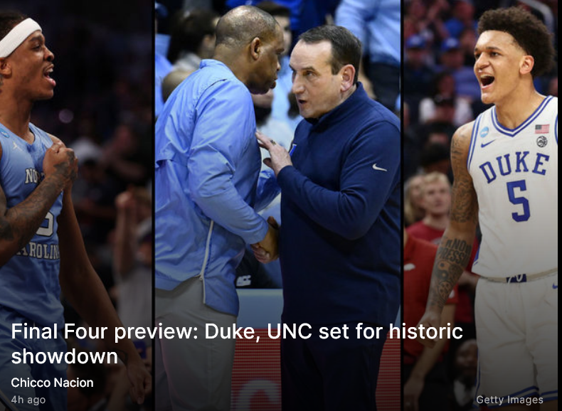
It’s Basketball History …
Quote & Photo credit: https://www.thescore.com/ncaab/news/2326440
Duke and North Carolina have squared off 257 times in their storied rivalry, but never in the NCAA Tournament.
The stakes couldn't be higher for their Final Four clash, with a berth in the national championship game on the line.
Can Coach K avenge last month's loss to the Tar Heels, or will the Hall of Famer's legendary career end at the hands of his longtime nemesis?

Slide 7
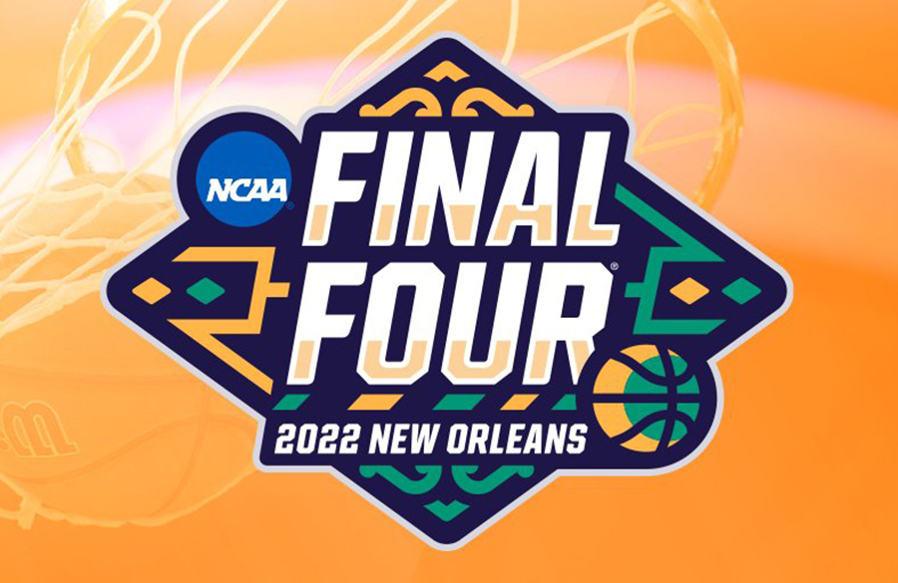
How Tar Heels Got to the Final Four …
Record: 28-9 (15-5 in ACC) Final AP Poll ranking: Unranked NCAA Tournament seed: No. 8 in East Region
First round: North Carolina 95, No. 9 Marquette 63 Second round: North Carolina 93, No. 1 Baylor 86 (OT) Sweet 16: North Carolina 73, No. 4 UCLA 66 Elite Eight: North Carolina 69, No. 15 Saint Peter's 49
Key stats
PPG: 78.1 (28th) RPG: 40.6 (6th) APG: 15.3 (39th) FT%: 76.5% (25th) 3PT%: 36.1% (54th) Opponent free-throw attempts per game: 13.4 (21st) Source: https://www.thescore.com/ncaab/news/2326440

Slide 8
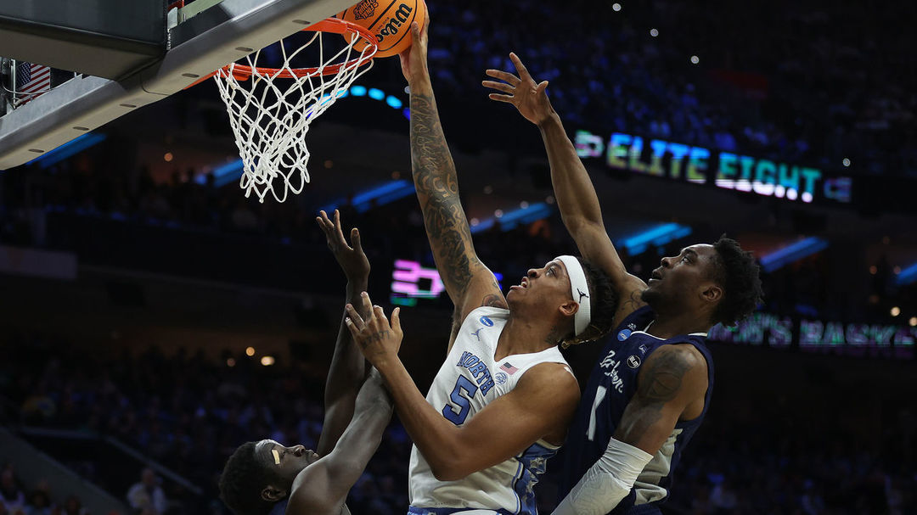
A Tar Heels’ Star Player - Armando Bacot
Bacot is coming off his most dominant performance of the Big Dance, posting 20 points, 14 boards (eight offensive), and two blocks in Sunday's win over Saint Peter's. It was his 29th double-double of the 2021-22 campaign, tying him with Tim Duncan for the most in ACC history.
Williams is undoubtedly a huge step up from the Peacocks' undersized frontcourt, but Bacot torched the Blue Devils for 23 points on 10-of-11 shooting just last month at Cameron Indoor Stadium. Saturday's result could easily hinge on whoever wins the big man battle. Source: https://www.thescore.com/ncaab/news/2326440

